Slide 1

UNICORN COMPANIES PROJECT ASSIGNMENT
COMPANIES DETAILS DASHBOARD USING PYTHON
MADE BY –ESSIEN HANNAH

Slide 2

EXECUTIVE SUMMARY
The dataset contains 10 columns and 1054 rows
The data consists of company name,valuation,date joined, industry,city, country, continent, year founded, funding and investors
The project is made by using python and charts

Slide 3

PROBLEM STATEMENTS
Countries with the highest ROI
How long it takes to be a unicorn company and has it always been this way?
Numbers of unicorn companies by country
Top industries in unicorn company
Unicorn Companies pie chart of industry distribution
Creating a heat map of valuation vs. funding
Unicorn Companies by Country using the map
The most valuable unicorn company in each country and sorting by valuation
The top 15 countries with the most unicorn companies and creating a bar chart

Slide 4

Observations 1 & 2
Observations 3 & 4
1)Countries with the highest ROI
2) How long it takes to become a unicorn company
3)Number of unicorn companies by country
4) Top Industries in Unicorn Companies
The observation of the top companies with the highest ROI underscores the significance of efficient resource allocation, strategic planning, and effective execution in achieving exceptional returns. These companies serve as examples of how businesses across diverse industries can generate substantial ROI, making them attractive prospects for investors.
The observation of the average years it takes to become a unicorn company highlights the dynamic and fast-paced nature of the startup ecosystem. It underscores the potential for startups to achieve significant valuations within a relatively short time frame, driven by innovation, investment, and market opportunities.
The observation of the number of unicorn companies by country highlights the global distribution of these high-growth startups. The United States and China lead in terms of quantity, but unicorn companies are thriving in diverse regions worldwide, offering investors a range of opportunities in the technology and innovation sectors.
The observation of top industries in unicorn companies underscores the dominance of technology-driven sectors, with e-commerce, software, and healthcare technology leading the way. Understanding these industry dynamics can inform investment decisions and business strategies within the unicorn ecosystem.

Slide 5
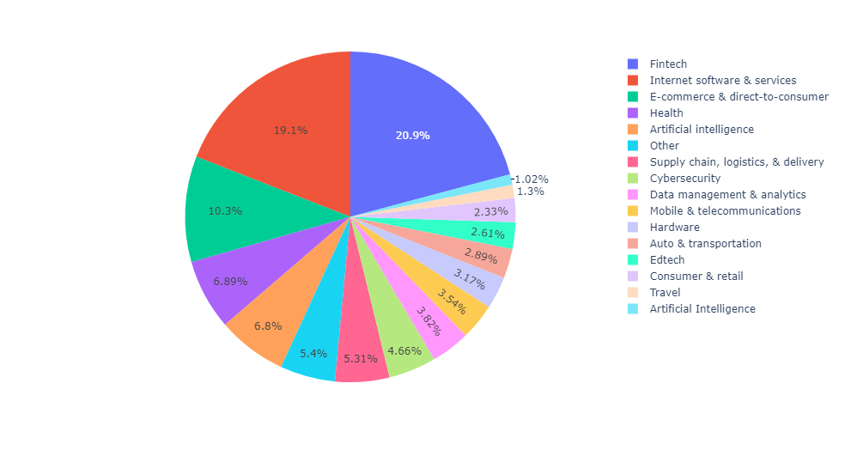
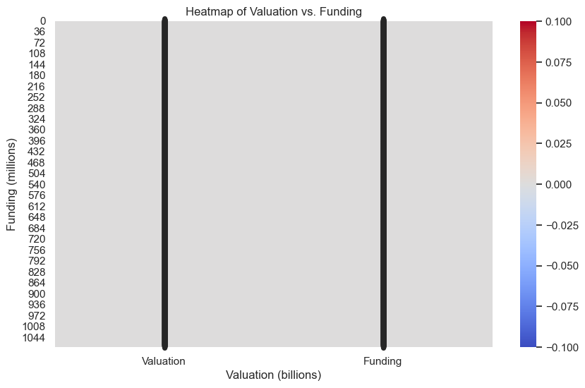
Observation 5 & 6 with pie chart & heat map
5) Unicorn Companies pie chart of industry distribution
6) Create a heat map of valuation vs. funding

Slide 6
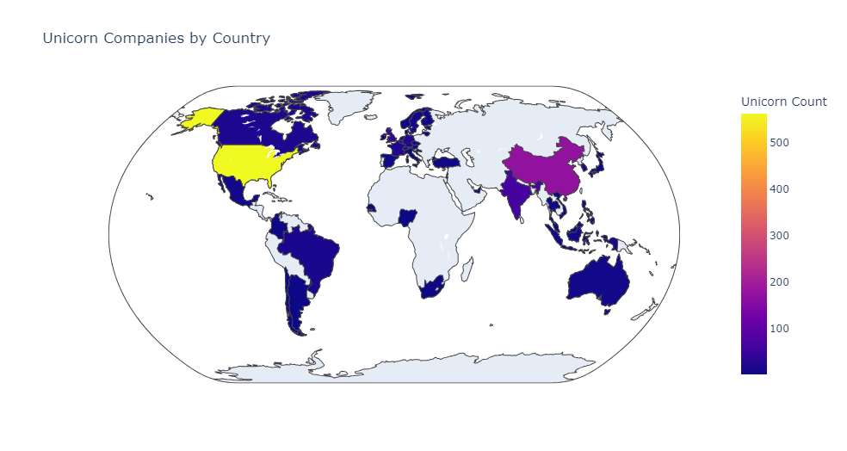
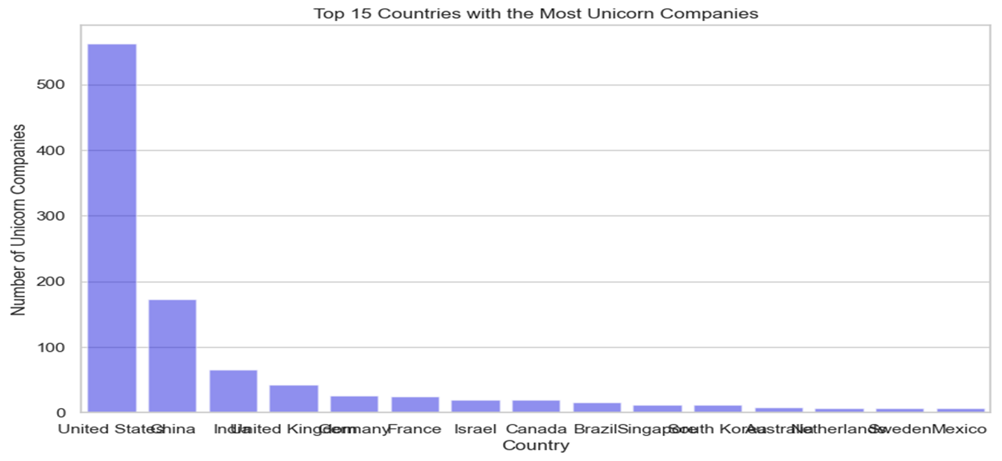
Observation 7,8,& 9
Unicorn Companies by Country using the map
The most valuable unicorn company in each country and sorting by valuation
To get the top 15 countries with the most unicorn companies and creating a bar chart
7) the map chart offers insights into the global distribution of unicorn companies, highlighting the concentration in certain tech hubs while emphasizing the potential for investment and collaboration across various countries.
8) These analysis highlights the global distribution of valuable unicorn companies, with variations in valuations among different countries. It emphasizes the importance of considering investment opportunities in countries with high-valued unicorns while recognizing the dynamic nature of the unicorn landscape.
9) These analysis reveals the countries with the most unicorn companies, highlighting the USA and China as significant hubs.

Slide 7

THANK YOU!
Essien Hannah

